Slide 1
Internet Multicasting
Prepared by
Divya K S
Adi Shankara Institute of Engineering & Technology
Kalady

Slide 2
Internet Multicasting
The IP protocol can be involved in two types of communication:
unicasting and multicasting.
Unicasting is the communication between one sender and one receiver.
It is a one-to-one communication.
However, some processes sometimes need to send the same message to a large number of receivers simultaneously.
This is called multicasting, which is a one-to-many communication.

Slide 3
Internet Multicasting
Multicasting is when a group of devices all receive the same messages or packets.
Multicasting works by sharing an IP address between multiple devices.
Any network traffic directed at that IP address will reach all devices that share the IP address, instead of just one device.
This is much like when a group of employees all receive company emails directed at a certain email alias.

Slide 4
Internet Multicasting
Multicasting has many applications.
For example, multiple stockbrokers can simultaneously be informed of changes in a stock price, or travel agents can be informed of a plane cancellation. Some other applications include distance learning and video-on-demand.
IGMP is a companion to the IP protocol.
IP supports multicasting, using class D addresses.
Each class D address identifies a group of hosts.
Twenty-eight bits are available for identifying groups, so over 250 million groups can exist at the same time

Slide 5
Internet Multicasting
In Internet Multicasting two kinds of group addresses are supported:
Permanent addresses and Temporary ones.
A permanent group is always there and does not have to be set up. Each permanent group has a permanent group address.
Some examples of permanent group addresses are:
224.0.0.1 All systems on a LAN
224.0.0.2 All routers on a LAN
224.0.0.5 All OSPF routers on a LAN
224.0.0.6 All designated OSPF routers on a LAN

Slide 6
Temporary groups
Temporary groups must be created before they can be used.
A process can ask its host to join a specific group.
It can also ask its host to leave the group.
When the last process on a host leaves a group, that group is no longer present on the host.
Each host keeps track of which groups its processes currently belong to.

Slide 7
Multicast routing
Multicast routing is done using spanning trees.
Each multicast router exchanges information with its neighbors, using a modified distance vector protocol in order for each one to construct
a spanning tree per group covering all group members.
Various optimizations are used to prune the tree to eliminate routers and networks not interested in particular groups

Slide 8
IGMP
IGMP is a network layer protocol used to set up multicasting on networks that use the Internet Protocol version 4 (IPv4).
IGMP allows devices to join a multicasting group.
The Internet Group Management Protocol (IGMP) is a protocol that allows several devices to share one IP address so they can all receive the same data
IGMP is not a multicasting routing protocol; it is a protocol that manages group membership.
In any network, there are one or more multicast routers that distribute multicast packets to hosts or other routers.
The IGMP protocol gives the multicast routers information about the membership status of hosts (routers) connected to the network.

Slide 9
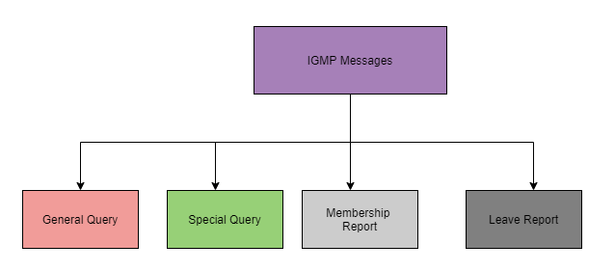
IGMP Messages
There are two versions of IGMP: IGMPv1 and IGMPv2.
The version IGMPv2 has three types of messages:
The Query
General
Special
The Membership report
The Leave report.

Slide 10
IGMP Messages
IGMP General Membership Query (MQ) messages :
Sent by local multicast routers to its connected subnets to identify the multicast groups which the multicast clients in the network are interested to subscribe.
IGMP Group-specific Multicast Query (MQ) messages
Used to determine the members of a particular multicast group.
IGMP Membership Report messages :
Sent by multicast clients inside the subnet to the router to inform the intention to join a multicast group or in response to a Membership Query (MQ) message sent by the router.
IGMP Leave Group (LG) messages :
Sent by multicast clients to local multicast routers to inform that they are no longer interested in a particular group.

Slide 11
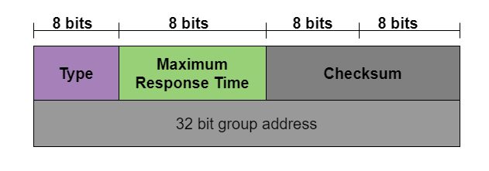
IGMP Message Format

Slide 12
IGMP Message Format
Type
This is an 8-bit field and is mainly used to define the type of the message. The value of the type can be in both hexadecimal as well as binary notations.
Maximum Response Time
The size of this field is also 8 bit and it mainly defines the amount of time in which query must be answered. The value of this field is nonzero in the query message; while its value is zero in the other two types.
Checksum
The size of this field is 16 bit and it carries the checksum. The checksum is mainly calculated over the 8-byte message.
Group Address
The value of this field is 0 in the case of the general query message. In the case of a special query, membership report, and leave report messages the value of this field defines the groupid.

Slide 13
Operations of IGMP
Joining a Group
Leaving a group
Monitoring Membership

Slide 14
Operations of IGMP
Joining a Group
A host or a router can join a group.
A host maintains a list of processes that have membership in a group.
When a process wants to join a new group, it sends its request to the host.
The host adds the name of the process and the name of the requested group to its list.
If this is the first entry for this particular group, the host sends a membership report message.
If this is not the first entry, there is no need to send the membership report.

Slide 15
Operations of IGMP
Leaving a group
When a host sees that no process is interested in a specific group, it sends a leave report.
Similarly, when a router sees that none of the networks connected to its interfaces is interested in a specific group, it sends a leave report about that group.
However, when a multicast router receives a leave report, it cannot immediately remove that group from its list.
This is because the report comes from just one host or router and there may be other hosts or routers that are still interested in that group.
To make sure, the router sends a special query message and wait for a specified time for any host or router to respond.
If during this time, no interest (membership report) is received, the router assumes that there are no loyal members in the network and remove the group from its list.

Slide 16
Operations of IGMP
Monitoring Membership
The multicast router is responsible for monitoring all the hosts or routers in a LAN to see if they want to continue their membership in a group.
The router periodically (by default, after every 125 s) sends a general query message.
The router expects an answer for each group in its group list; even new groups may respond.
The query message has a maximum response time of 10 s
query message must be sent by only one router (normally called the query router), also to prevent unnecessary traffic

Slide 17
Working of IGMP
IGMP works on devices that are capable of handling multicast groups and dynamic multicasting.
These devices allows the host to join or leave the membership in the multicast group.
This communication protocol is operated between host and local multicast router.
When a multicast group is created, the multicast group address is in range of class D (224-239) IP addresses and is forwarded as destination IP address in the packet.

Slide 18
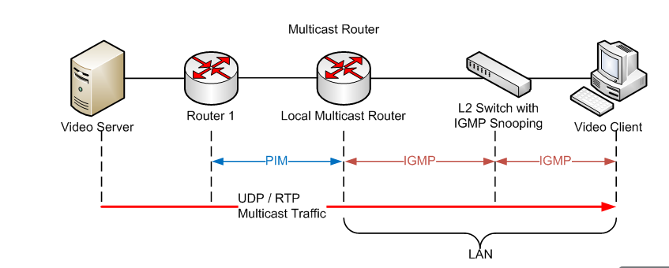
Working of IGMP
PIM (Protocol Independent Multicast)

Slide 19
Working of IGMP
L2 or Level-2 devices such as switches are used in between host and multicast router for IGMP snooping.
IGMP snooping is a process to listen to the IGMP network traffic in controlled manner.
Switch receives the message from host and forwards the membership report to the local multicast router.
The multicast traffic is further forwarded to remote routers from local multicast routers using PIM (Protocol Independent Multicast) so that clients can receive the message/data packets.
Clients wishing to join the network sends join message in the query and switch intercepts the message and adds the ports of clients to its multicast routing table.

Slide 20
Advantages and disadvantages IGMP
Advantages of IGMP
With the help of this protocol, the bandwidth is utilized efficiently aa because all the shared links are connected.
Using this protocol, the host can immediately leave a multicast group and then join another group.
The performance of this protocol is optimized as there is no transmission of junk packets to the host.
Disadvantages of IGMP
Given below are some of the drawbacks of the IGMP :
During filtering and security, it does not offers good efficiency.
This protocol is vulnerable to Denial of Service(DoS) attacks.
Network congestion can occur due to a lack of TCP.

